Slide 1


TripAdvisor Insights
Machine Learning on TripAdvisor Data
Presented by Orit Padawer, Future Data Scientist
November 12, 2025

Slide 2
Introduction and Dataset Overview
Analyzing TripAdvisor Ratings for Success
- Platform: Tripadvisor – global restaurant ratings (1–5 scale)
- Goal: Predict restaurant success (avg_rating ≥ 4.5 & higher than mean review count)
- Focus: Italian restaurants only
2

Slide 3

Full ML Pipeline
Overview of Presentation Topics and Structure
Data Exploration and Preparation
Missings and Outlier Treatment
Feature Engineering and Selection
Modeling and Results Insights
3

Slide 4

Data Preparation Steps
Steps for a refined dataset
  Filtered for Italian restaurants
  Cleaned text from punctuation, standardized categories
  Reconstructed geographic hierarchy (Region → Province → City)
  Turning List columns into features
  Created binary target: high-rated (4.5<=)+ larger than mean reviews = success
4

Slide 5
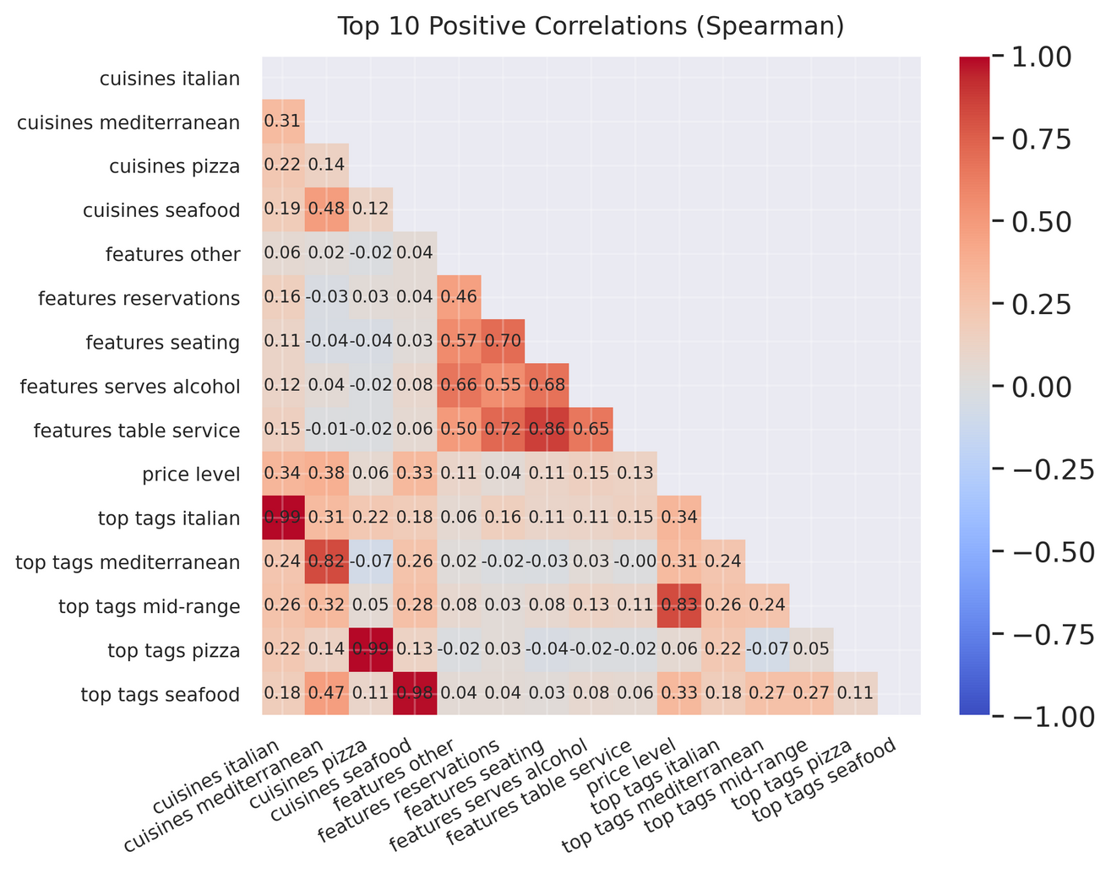
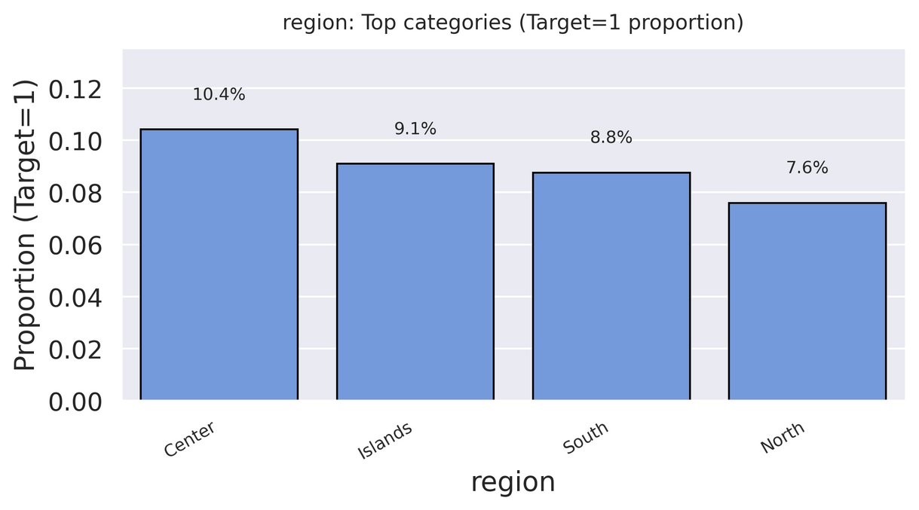
Exploratory Data Analysis (EDA)
Analyzing TripAdvisor Ratings for Success
•Ratings features (food, service, value) leak target → excluded
•Central Italy shows higher success rates
•English-language visibility correlates with high ratings
•Numeric features (e.g. max_price) are highly skewed
5

Slide 6
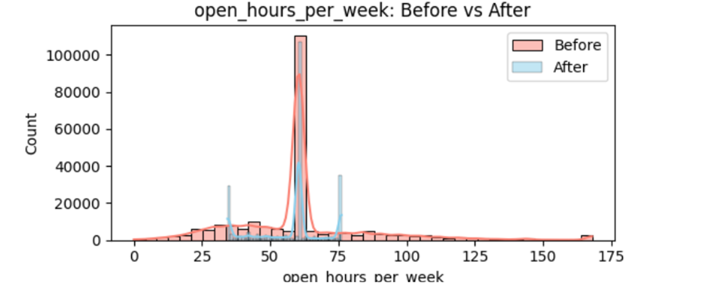
Data Imputation & Outlier Control
Analyzing TripAdvisor Ratings for Success
•KNN imputation for operational metrics
•City/province medians for missing coordinates
•IQR capping (1.5× rule) for numeric outliers
•Result: complete, stable, and consistent dataset
6

Slide 7


Feature Engineering and Data Splitting Techniques
Engineering
Splitting
This phase involved creating new variables based on spatial location and business attributes, such as distance to city center, area popularity, and restaurant chain status for better predictive analysis.
Dividing data into training and testing sets.
7

Slide 8
Modeling & Feature Selection
Evaluating Models for Restaurant Success Prediction
•Pipeline: Preprocessing → VarianceThreshold → SelectKBest → SMOTE → Classifier
•Models tested: Logistic Regression, Random Forest, XGB, LinearSVM, Decision Tree, AdaBoost, GBM
•Evaluation: ROC-AUC, F1, Precision, Recall, Accuracy, Log Loss
8

Slide 9
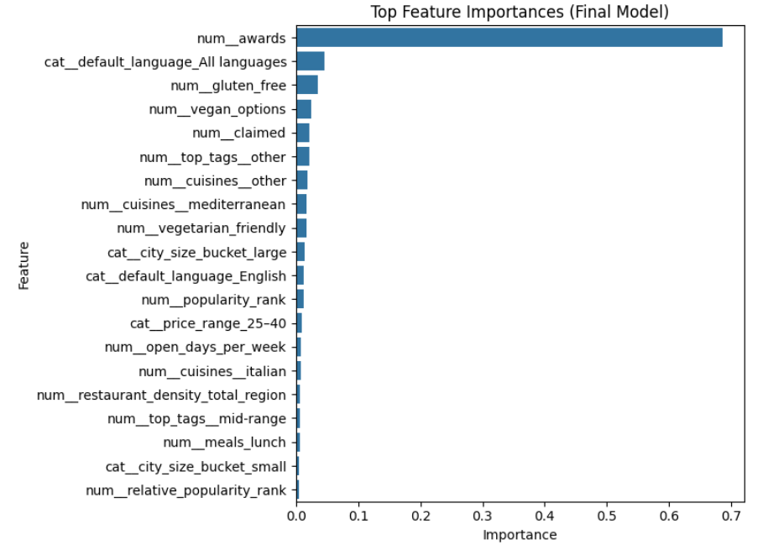
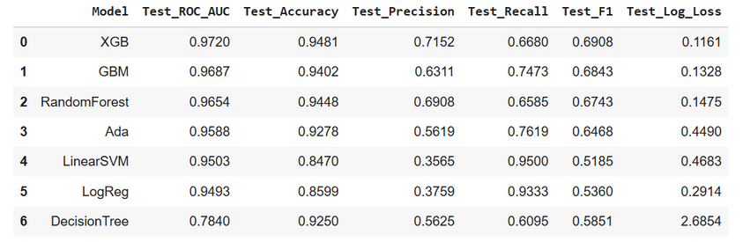
Results & Key Insights
Insights on Success Factors in Italy
•Top drivers of success:
•Central location & dense areas
•English-language visibility
•Inclusivity (vegan, gluten-free, vegetarian)
•Michelin prestige & winning awards
•XGBoost was top performer
•Final results after Tuning:
Accuracy: 0.9483, Precision: 0.7107, Recall: 0.6811, F1: 0.6956,
ROC AUC: 0.972
9

Slide 10

Thank you for your attention!
Data Insights Co.

